Slide 1

Term-III * Machine Learning Foundation
Avocado Price Prediction Project

Slide 2

CONTENTS
01 Project Brief & Problem Statement
02 EDA Summary
03 Prediction Algorithms
04 Model Summary & Conclusion

Slide 3
01
Project Brief & Problem Statement
Dataset shared is having details about Avocado price for various dates of 2015, 2016, 2017 and 2018
The dataset contains weekly retail scan data for National Retail Volume (units) and price.
Retail scan data comes directly from retailers’ cash registers based on actual retail sales of Hass avocados.
The column “AveragePrice” is the average price of a single avocado.
Task is to predict the optimal price of the avocado using the previous sales data of avocado according to different regions.

Slide 4
02
EDA Summary
Column Name | Description
Id | Unique identity of each observation.
Date | The date of the observation.
AveragePrice | The average price of a single avocado.
Total Volume | Total number of avocados sold.
4046 | Total number of avocados with PLU 4046 sold.
4225 | Total number of avocados with PLU 4225 sold.
4770 | Total number of avocados with PLU 4770 sold.
Total Bags | Total number of bags sold.
Small Bags | Total number of small bags sold.
Large Bags | Total number of large bags sold.
XLarge Bags | Total number of extra-large bags sold.
type | Type of an avocado (conventional or organic).
year | The year of observation.
Region | The city or region of the observation.
Dataset Having 14 Columns

Slide 5
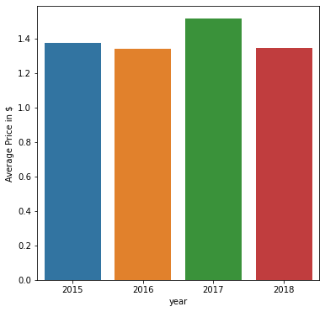
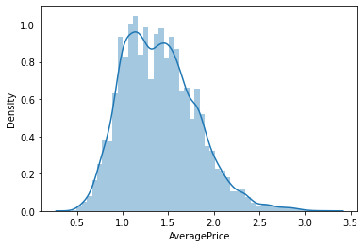
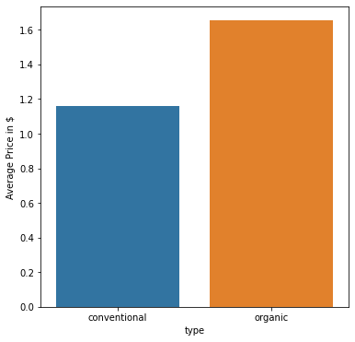
02
EDA Summary
There is a spike in price during 2017 and mostly same during 2015, 2017 and 2018
Organic Avocados are expensive than conventional

Slide 6
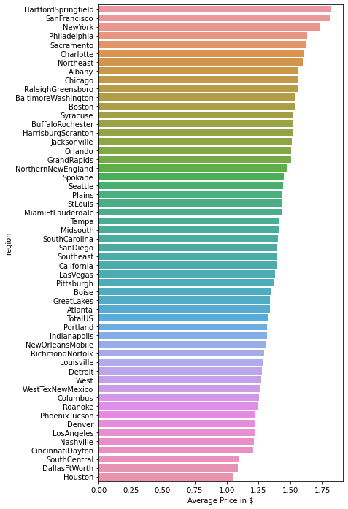
02
EDA Summary
54 regions available in the dataset
Average Price varied at each region
Price varied from 1$ to 1.75$

Slide 7
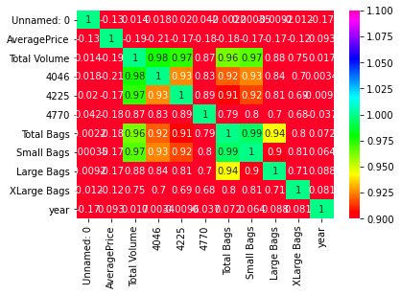
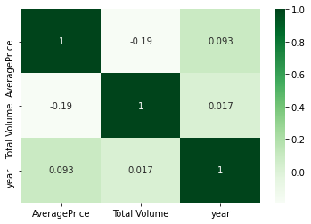
02
EDA Summary
After dropping multi collinearity columns, it is evident no relation between columns
We can observe multicolleaniarity between Total Volume, 4046, 4225, 4770, Total Bags, Small Bags, Large Bags and XLarge Bags
So we are going drop all columns except Total Volume before we proceed further
Also Unnamed:0 column also containing the ID nos of observations which also can be dropped

Slide 8
03
Prediction Algorithms
As the data is continuous, have taken below algorithms to predict the Average Price of Avocado
Linear Regression
Decision Tree
Random Forest
GridSearchCV
RandomizedSearchCV

Slide 9
04
Model Summary & Conclusion
Model | RMSE | R-Square | Adjusted R-square
Linear Regression | 0.659166 | 0.566261 | 0.559256
Decision Tree | 0.581627 | 0.662303 | 0.656849
Random Forest | 0.476693 | 0.773162 | 0.769498
GridSearchCV | 0.554303 | 0.693287 | 0.688333
RandomizedSearchCV | 0.707377 | 0.500495 | 0.492427
After reviewing with the test data (20% of dataset) with Linear Regression, Decision Tree, Random Forest, GridSearchCV and RandomizedSearchCV models, best prediction model for this data is Random Forest.

Slide 10
THANK YOU

